Slide 1
Thesis Protein Translocation through a nanopore
Name- Rajat Chaudhary
Roll No. -17807540
Mentor - Dr. Harshwardhan H. Katkar

Slide 2
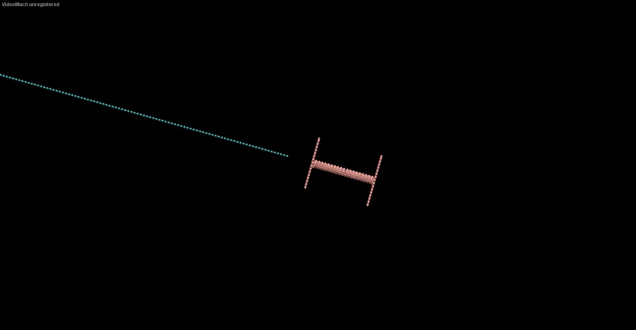
Pore Size
For a diameter of 5: Translocating
For a diameter of 2:
Not Translocating

Slide 3
Protein Unfolding
Denaturing through external agent and using nanopore translocation to judge the current state of unfolding in the protein – Folded, partially unfolded, completely unfolded
Manipulating pore size and driving force to change the protein state without external agent

Slide 4
Future Objectives
Obtain the time distribution of translocation
Find a way to simulate secondary structures of protein
Obtain the time distribution of the protein translocation
Try to find a correlation between translocation time distribution and secondary structure

